Slide 1

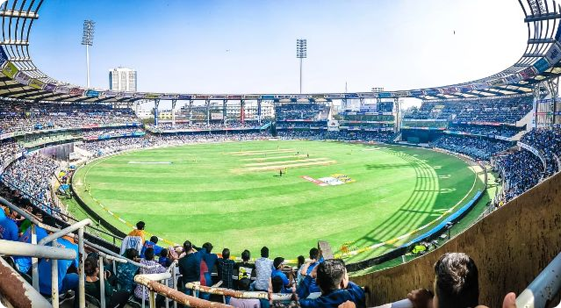
Introduction to IPL Analysis
The Indian Premier League (IPL) is one of the world's most
popular and lucrative cricket tournaments. This analysis explores the rich data behind the IPL, uncovering insights into team performance, player statistics, and match outcomes through SQL and Python visualizations.
By- Vivek Kumar Dixit

Slide 2

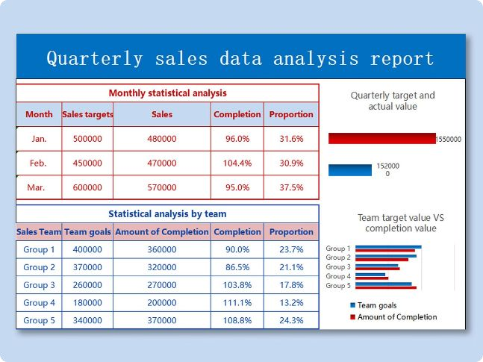
Data Collection and Preprocessing
Data Sources
Collect IPL match data, player statistics, and team information from reliable sources like Cricinfo and IPL official websites.
Data Cleaning
Handle missing values, remove duplicates, and standardize data formats to ensure accuracy and consistency.
Feature
Features like win-loss ratio, strike rate, and economy rate to enrich the dataset for deeper analysis.

Slide 3

Exploratory Data Analysis (EDA) using SQL
Data Exploration
Insights Extraction
Extract meaningful insights from the data to understand factors contributing to team and player success in the IPL.
Team Statistics
Analyze team-level data such as win-loss records, run rates, and player performances to identify top-performing teams.
Use SQL to explore the dataset, uncover patterns,
and identify key variables that influence IPL performance.
1
2
3

Slide 4
Visualizing IPL Data with Python
Seaborn
Leverage Seaborn's statistical data visualization capabilities to explore relationships between various IPL variables.
Plotly
Employ Plotly's interactive and dynamic visualizations to present complex IPL data in an engaging and informative manner.
Use Matplotlib to create high-quality, customizable
visualizations like line charts, bar plots, and scatter plots.

Slide 5
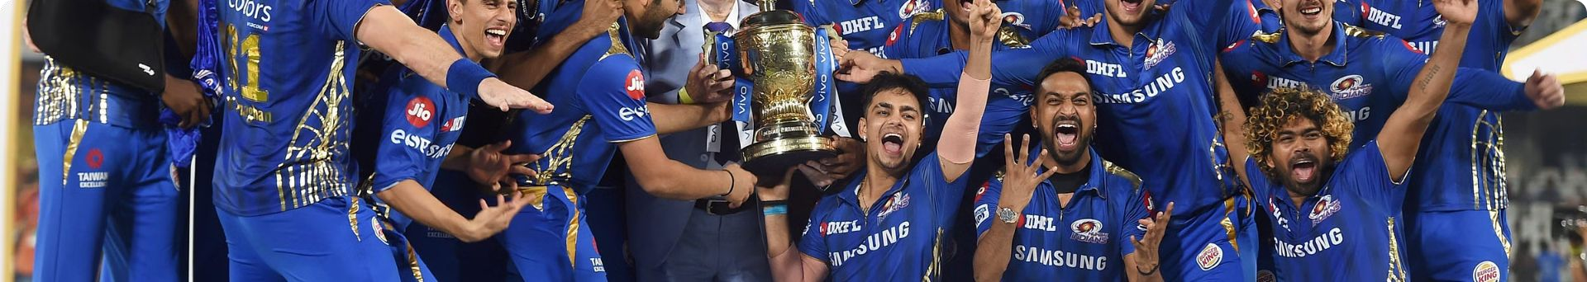
Analyzing Team
Home vs. Away
Analyze how teams perform at their home grounds versus away matches to understand the impact of home field advantage.
1
Performance
Examine each team's win-loss ratio to identify
the most consistent and successful franchises in the IPL.
2
Batting and Bowling
Team’s batting and bowling performances to identify their strengths and weaknesses.
Playoff Performance
Performance in the IPL playoffs to uncover the characteristics of championship-winning squads.
3
4

Slide 6


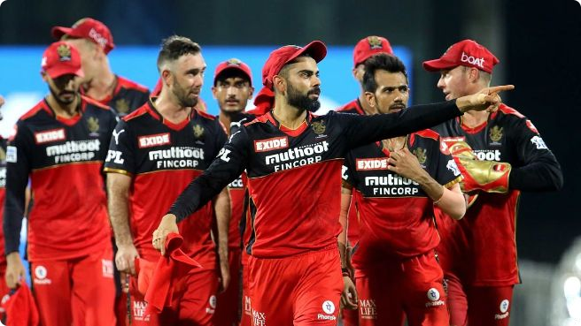


Player Statistics and Insights
Batting
Analyze batting statistics like runs scored, strike rate, and centuries to identify the most consistent and high-performing batters.
Bowling
Evaluate bowling metrics such as wickets taken, economy rate, and bowling averages to pinpoint the most effective bowlers in the IPL.
Fielding
Assess players' fielding contributions through stats like catches, run-outs, and diving saves to recognize the All-Rounders.

Slide 7

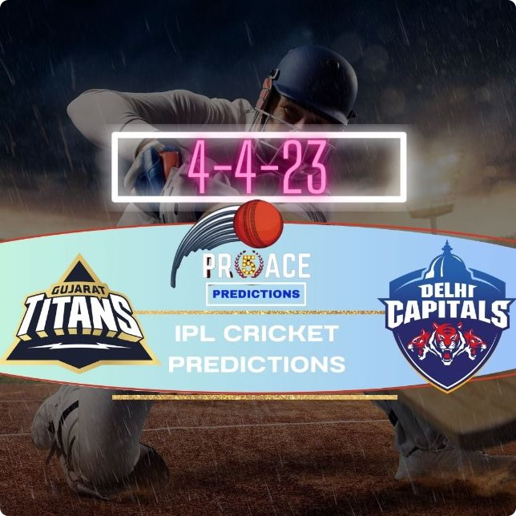

Predicting Match out comes
Preparation
Clean and engineer features from the IPL dataset to
create a suitable machine learning model input.
Model Selection
Choose an appropriate machine learning algorithm, such as logistic regression or decision trees, to predict match outcomes.
Model Training
Test its accuracy, and fine-tune hyperparameters to optimize its predictive performance.

Slide 8

Conclusion and Recommendations
The analysis has revealed important patterns in
team performance, player statistics, and match outcomes that can guide strategic
decision-making for IPL franchises.
Future Improvements
Incorporating additional data sources, such as
weather conditions and pitch reports, could further enhance the predictive capabilities of the match outcome model.
Recommendations
The findings from this comprehensive IPL analysis
can help teams optimize their player recruitment, in-game tactics, and overall strategy to achieve greater success in the tournament.

Slide 9
Thank You

